Slide 1
Your Office
Microsoft Excel 2013 Comprehensive
Excel
Effective Charts
Notes:
In this workshop, you learn about data visualization, which is the graphical presentation of data with a focus upon qualitative understanding.

Slide 2
Objectives
Explore chart types, layouts, and styles
Explore the positioning of charts
Understand different chart types
Change chart data and styles for presentations
Notes:
The objectives for this workshop are:
Explore chart types, layouts, and styles
Explore the positioning of charts
Understand different chart types
Change chart data and styles for presentations
The objectives continue on the next slide.

Slide 3
Objectives (Continued)
Edit and format charts to add emphasis
Use sparklines and data bars to emphasize data
Recognize and correct confusing charts
Notes:
Additional objectives are:
Edit and format charts to add emphasis
Use sparklines and data bars to emphasize data
Recognize and correct confusing charts

Slide 4
Explore Chart Types, Layouts, and Styles
Initial decisions about the basic chart design:
The location of the chart
The type of chart
The general layout and style
The data used
Notes:
When representing data visually, you need to make some initial decisions about the basic design of the chart.
These initial decisions include:
The location of the chart
The type of chart
The general layout and style
The data used
Information on exploring chart types, layouts, and styles continues on the next slide.

Slide 5
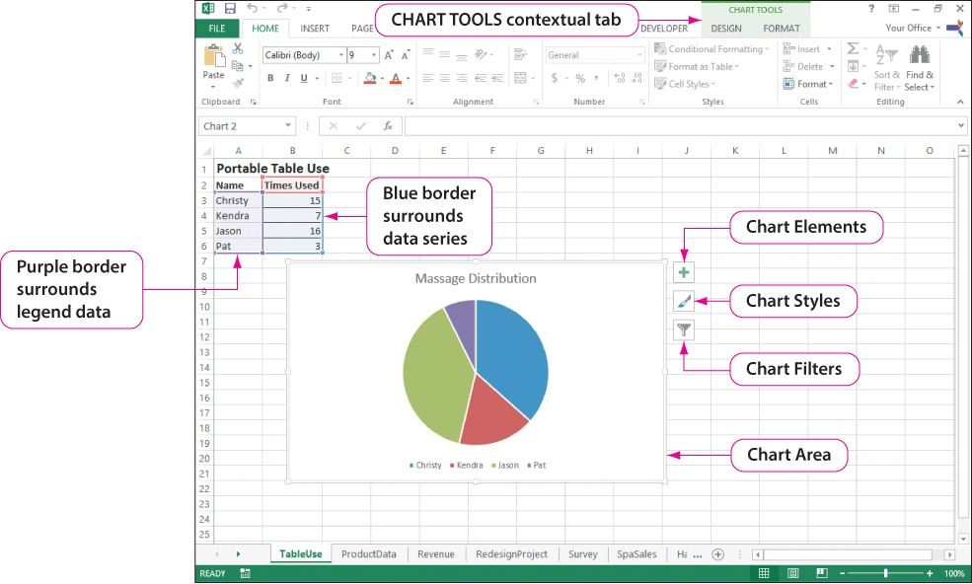
Explore Chart Types, Layouts, and Styles
Notes:
A data series is a group of related data values to be charted. A data point is an individual data value in a data series. A chart might contain multiple data series or a single data series.
We begin by modifying an existing chart. Click the chart border to display the CHART TOOLS contextual tabs. Take a few minutes to familiarize yourself with the various chart components and chart tools.
Information on exploring chart types, layouts, and styles continues on the next slide.

Slide 6
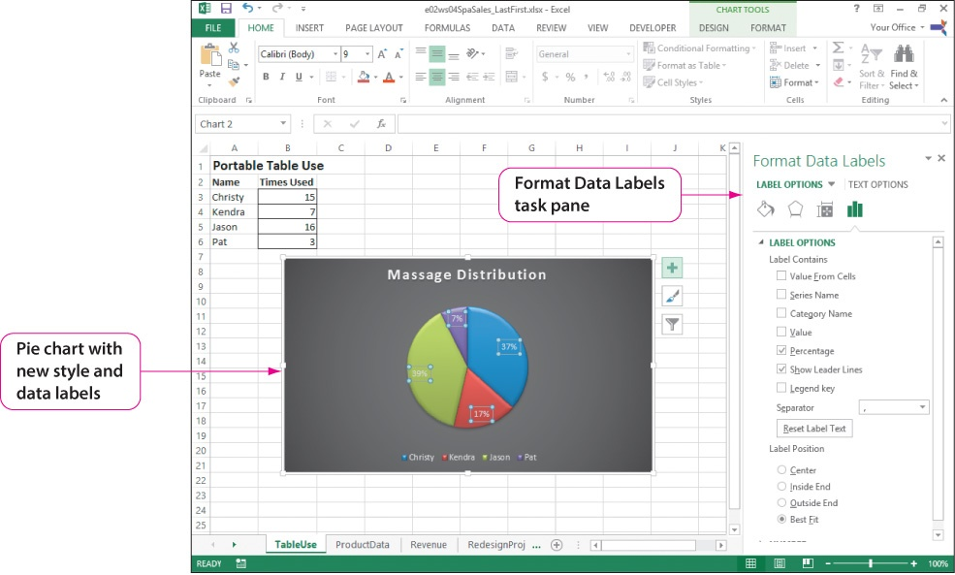
Explore Chart Types, Layouts, and Styles
Notes:
As an example of a chart modification, we change the labels. To the right of the chart, click Chart Elements. If necessary, refer to the previous slide to see the location for the Chart Elements button. Click Data Labels from the Chart Element list, and the labels will be displayed in chart. Click the Data Labels arrow and from the list, click More Options to display the Format Data Label task pane, which is shown in the slide. Take a few minutes to familiarize yourself with the various label options shown in the task pane. By checking Percentages, you can see that the percentages are displayed in each slice. Although we will not discuss how, you can also see the style of the pie chart has been changed.
Information on exploring chart types, layouts, and styles continues on the next slide.

Slide 7
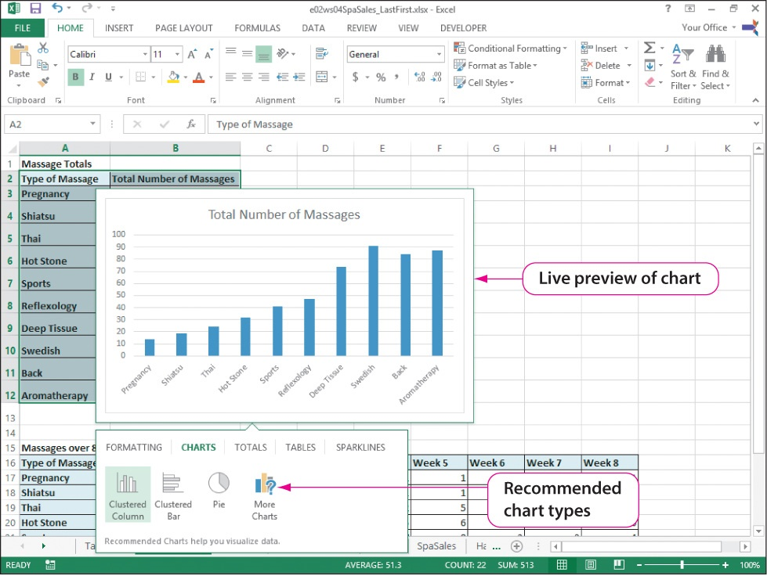
Explore Chart Types, Layouts, and Styles
Notes:
When creating a chart, you should consider the chart location, because this might affect the flexibility of moving and resizing your chart components. There are two general locations for a chart—either within an existing worksheet or on a separate worksheet, referred to as a chart sheet, which is a special worksheet that is dedicated to displaying chart objects.
To create a chart, select the range of cells, click the Quick Analysis tool, click Charts, and point to each of the suggested chart types. As you point to each, Live preview displays the chart. Once you decide which chart type, click it.

Slide 8
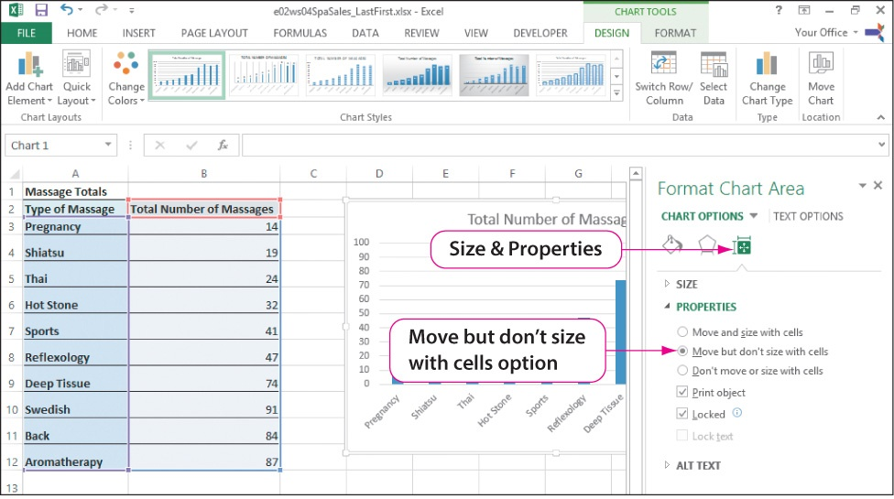
Explore the Positioning of Charts
Notes:
Charts created within the worksheet appear as objects that “float” on top of the worksheet. One method for moving a chart is to place the pointer on a chart’s border, and when it changes to a four-way arrow, drag the chart to the desired location. In a similar manner, a chart can be resized by placing the pointer on one of the border sizing handles and dragging to change its size. You can also right-click the chart’s border, and click Format Chart Area from the shortcut menu to open the Format Chart Area task pane. As shown in the slide, there are several task pane options from which to choose.
To move a chart to a chart sheet, select the chart, click Move Chart in the Location group on the CHART TOOL DESIGN tab to display the Move Chart dialog box. One of the choices is to move it to a new sheet and name the sheet.

Slide 9
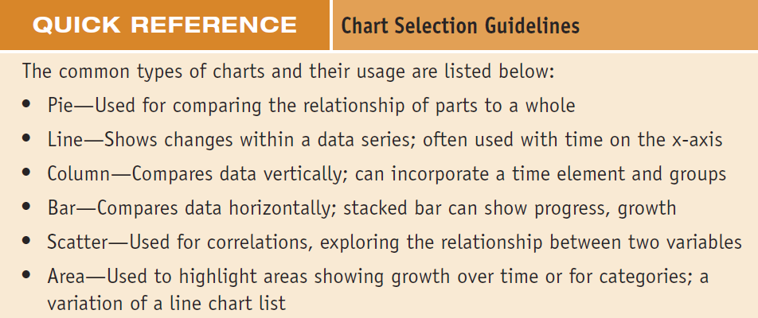
Understand Different Chart Types
Notes:
Pie charts are commonly used for depicting the relationships of the parts to the whole, such as comparing staff performance within a department or comparing the number of transactions of each product category within a time period.
Line charts help convey change over a period of time. They are great for exploring how data in a business, such as sales or production, changes over time.
Column charts are useful for comparing data sets that are categorized, such as departments, product categories, or survey results. Column charts are also useful for showing categories over time where each column represents a unit of time.
Bar charts are useful for working with categorical data. Bar charts are similar to column charts, except the bars are horizontal representations of the data rather than vertical.
Scatter charts, also called scatter plots, are a particular type of chart that conveys the relationship between two numeric variables. This type of chart is common as a statistical tool depicting the correlation between the two variables.
An area chart is a variation of a stacked line chart that emphasizes the magnitude of change over time and visually depicts a trend. The area chart stacks a set of data series and colors each area that is created.
Let’s look at three chart types with which you might not be familiar.
Information on understanding different chart types continues on the next slide.

Slide 10
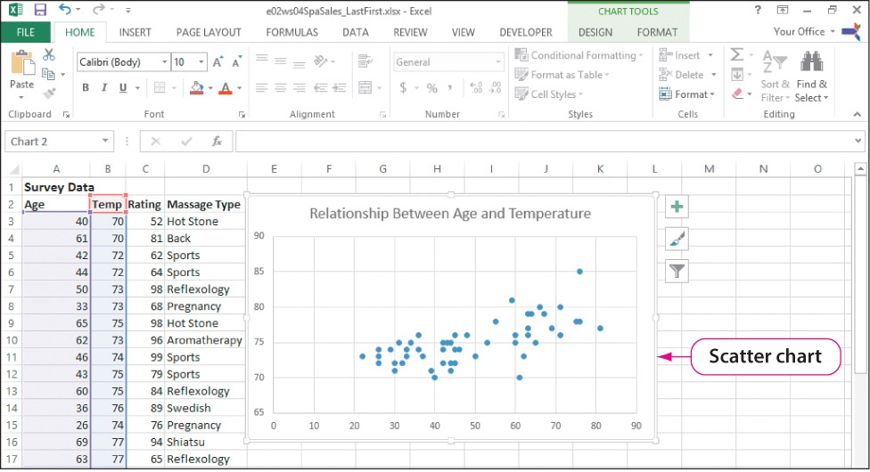
Understand Different Chart Types
Notes:
Recall that a scatter chart conveys a relationship between two numeric variables. In this slide, the chart is used to see whether there is any correlation between the age of the participants—the horizontal or x-axis—and the requested room temperature—the vertical or y-axis.
Information on understanding different chart types continues on the next slide.

Slide 11
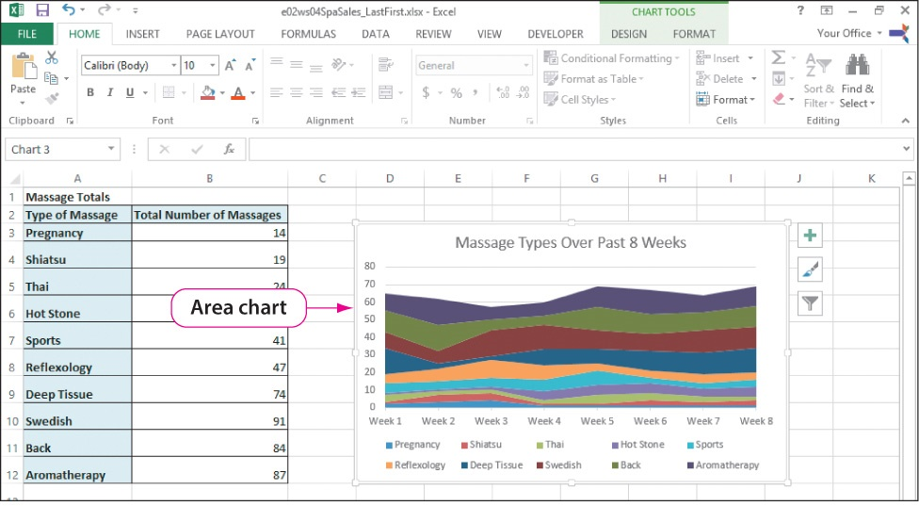
Understand Different Chart Types
Notes:
Remember that an area chart is a variation of a stacked line chart that emphasizes the magnitude of change over time and stacks a set of data series and colors to create each area. In this slide, the chart is used to understand the differences in the types of massages over the time span of eight weeks.
Information on understanding different chart types continues on the next slide.

Slide 12
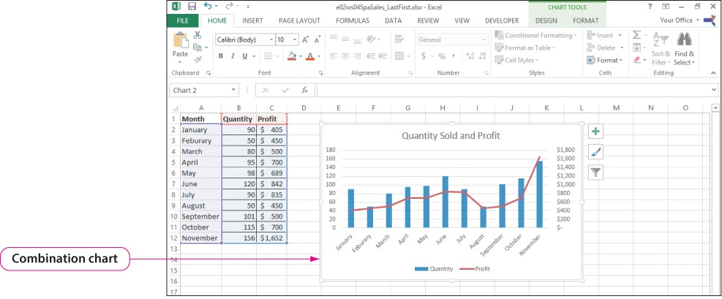
Understand Different Chart Types
Notes:
A combination chart displays two different types of data by using multiple chart types in a single chart object. Combination charts can enhance the understanding of data when the scale of data needing to be charted varies greatly.
What two chart types are used in the combination chart shown in the slide?

Slide 13
Change Chart Data and Styles for Presentations
Chart changes can be made by modifying:
Layouts
Styles
Labels
Colors
Objects can be added to a chart:
Pictures
Shapes
Notes:
When presenting a chart to others, the context of the chart is of utmost importance. Without context, your audience will try to guess the context. Providing context means providing textual information to the audience. The use of labels such as the chart title and axes titles, the legend, and the labels for the data gives meaning to your chart.
You can make changes to a chart by modifying a chart’s:
Layouts
Styles
Labels
Colors
You can also add objects such as:
Pictures
Shapes
Information on changing chart data and styles for presentations continues on the next slide.

Slide 14
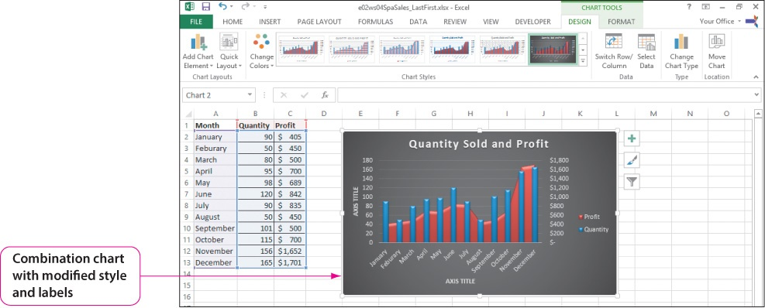
Change Chart Data and Styles for Presentations
Notes:
Excel provides chart layouts with many options for arranging the components on a chart. This includes the placement of the titles and legend as well as the display of information such as the data point values.
In this example:
The chart style has been changed by clicking Change Chart Type in the Type group on the CHART TOOLS DESIGN tab and selecting the desired chart type from the Change Chart Type dialog box.
The chart layout has been changed by clicking the Chart Styles button and selecting the desired style from the Style Gallery. Note that Layout 9 was chosen in the slide example, which adds x- and y-axis labels.
Information on changing chart data and styles for presentations continues on the next slide.

Slide 15
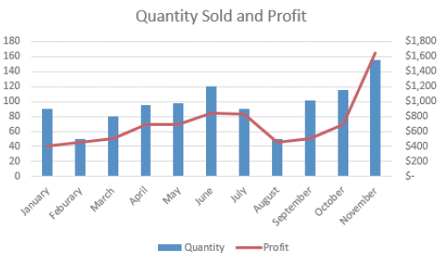
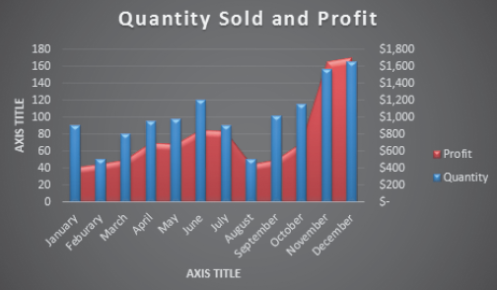
Change Chart Data and Styles for Presentations
Notes:
To see the improvement, compare this chart to its original version shown on Slide 12.
Information on changing chart data and styles for presentations continues on the next slide.

Slide 16
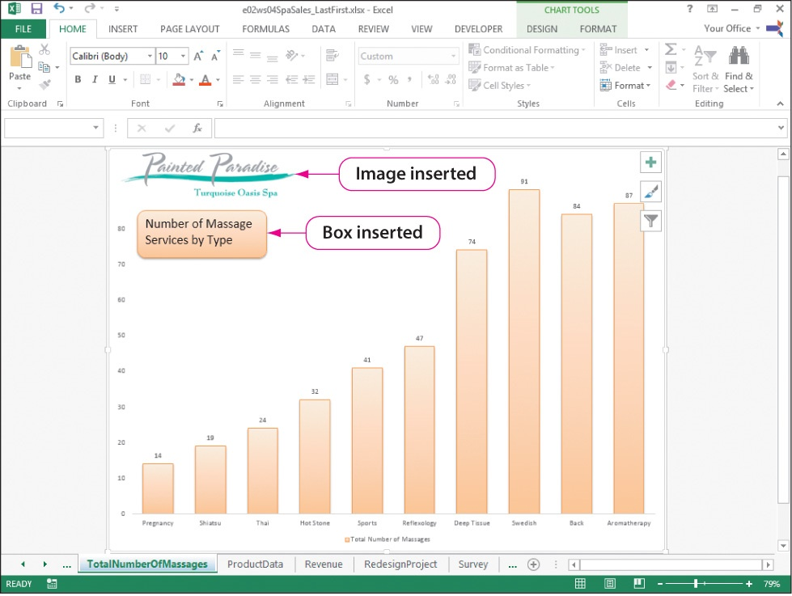
Change Chart Data and Styles for Presentations
Notes:
You can add visual appeal to a chart by inserting objects. In this example, an image of a company logo and a shape with text is added to a chart.
To insert an image, click Pictures in the Illustrations group on the INSERT tab. Use the Insert Picture dialog box to navigate to and select the desired image. Once the image is inserted, it can be resized, repositioned, and formatted.
To insert a shape, click Shapes in the Illustrations group on the INSERT tab. Select the desired shape from the Shapes gallery. Once a shape is inserted, text can be added to it, the shape can be resized, repositioned, and formatted.
Information on changing chart data and styles for presentations continues on the next slide.

Slide 17
Change Chart Data and Styles for Presentations
Textual chart enhancements:
Chart title
Axes titles
Legend
Data labels
Notes:
As mentioned at the beginning of this workshop, the addition of textual information, such as the chart and axes titles, a legend, and the labels for the data, helps the audience understand the meaning of your chart.
The simplest method for changing the text of a chart title is to click in the title, select the existing text, and type the new text. In a similar manner, you can click an axis title, enter new text, or you can press Delete to remove the selected axis title.
Some charts have a legend automatically added. When the parts are labeled on the chart, the legend is not needed and can be removed. To add, remove, or modify a legend, click the Chart Elements button and check or uncheck legend. To make modifications, click the Legend arrow and select a location change.
Data labels can be added, moved, or removed through the Chart Elements button in a manner similar to the sequence described previously for legends. You can also use options on the CHART TOOLS DESIGN tab.
Information on changing chart data and styles for presentations continues on the next slide.

Slide 18
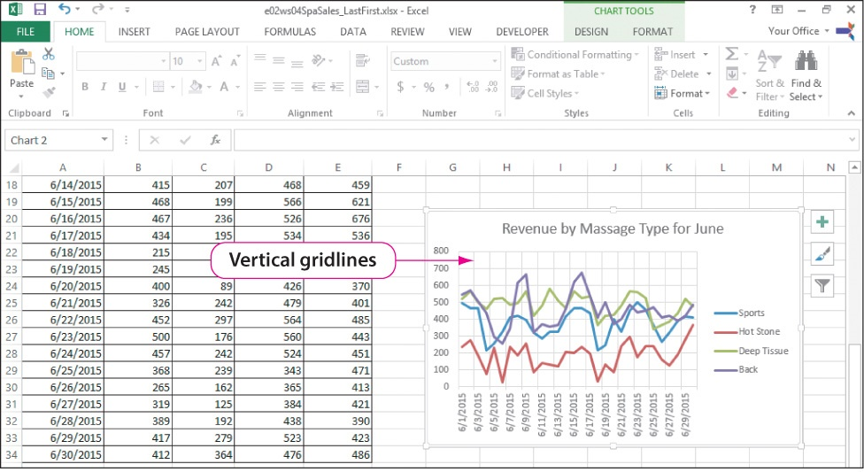
Change Chart Data and Styles for Presentations
Notes:
Another chart enhancement is the use of gridlines, which are the lines that go across charts to help indicate the size of the bars, columns, or data lines.
There are two types of gridlines:
Major gridlines—Gridlines at the designated label values
Minor gridlines—Gridlines between the label values
As we have seen with previous chart objects, click the Chart Elements button and check or uncheck Gridlines. To make modifications, click the Gridlines arrow and select which axis—horizontal or vertical—and which gridline—major or minor.
Information on changing chart data and styles for presentations continues on the next slide.

Slide 19
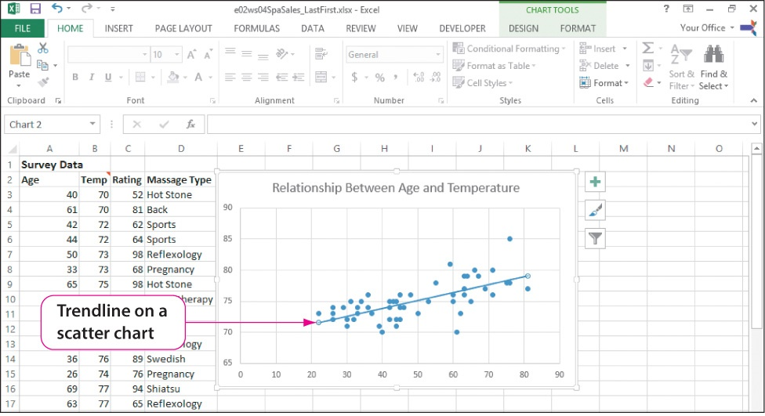
Change Chart Data and Styles for Presentations
Notes:
Our final enhancement is the addition of a trendline. A trendline is a line that uses current data to show a trend or general direction of the data.
Excel’s four trendlines are:
Linear trendline—Adds/sets a linear trendline for the selected chart series.
Exponential trendline—Adds/sets an exponential trendline for the selected chart series.
Linear Forecast trendline—Adds/sets a linear trendline with a two-period forecast for the selected chart series.
Two-Period Moving Average trendline—Adds/sets a two-period moving average trendline for the selected chart series.
In this example, a linear trendline is added to a scatter chart by clicking the Chart Elements button, clicking the Trendline arrow, and clicking More Options. In the Format Trendline task pane, click Fill & Line, click the Dash type arrow, and then click Solid.
Looking at the trendline, what is the relationship between the age of the clients and the temperature of the room they request?

Slide 20
Edit and Format Charts to Add Emphasis
Chart formatting options:
Number
Fill
Border Colors and Styles
Shadow
Glow and Soft Edges
3-D Format
Alignment
Notes:
In this workshop, we learn how to add emphasis to charts.
This can take many forms:
Number—Format data as currency, date, time, and so on.
Fill—Fill the background of a component with a color, picture, or pattern.
Border Color—Set the color of the border for a component.
Border Styles—Set the thickness and type of border for a component.
Shadow—Add shadowing effect to a component.
Glow and Soft Edges—Add glow and edge effects to a component.
3-D Format—Add 3-D effects to component.
Alignment—Align text direction for a component, such as left, top, vertical, or horizontal.
Another emphasis limited to pie charts is the ability to explode a slice or slices. This and some of the other options is shown in the next slide.
Information on editing and formatting charts to add emphasis continues on the next slide.

Slide 21
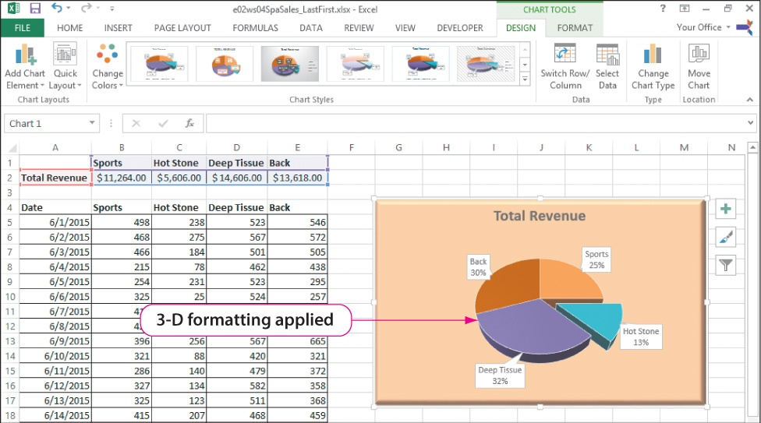
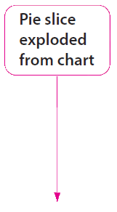
Edit and Format Charts to Add Emphasis
Notes:
As indicated by the slide callouts, the original pie chart has been converted into a 3-D pie chart, and the Hot Stone slice has been exploded away from the remainder of the pie chart.
To make the pie three-dimensional, click Charge Chart Type in the Type group on the CHART TOOLS DESIGN tab, click All Charts in the Change Chart dialog box, and click 3-D Pie. To explode a pie slice, click the Hot Stone slice and then drag it to the desired location.
Information on editing and formatting charts to add emphasis continues on the next slide.

Slide 22
Edit and Format Charts to Add Emphasis
Notes:
To see the improvement, compare this pie chart to its original version shown in the text.

Slide 23
Use Sparklines and Data Bars to Emphasize Data
Sparklines:
Are small embedded charts
Facilitate quick analysis of treads
Depict data over time
Data bars:
Are graphic components overlaid onto data
Are added to a cell and interpret a set of data
Are solid or gradient fill
Notes:
Sparklines are small charts that are embedded into the cells in a worksheet, usually beside the data, to facilitate quick analysis of trends. A sparkline can be used within a worksheet to give an immediate visual trend analysis, and it adjusts as the source data changes. Sparklines can graphically depict the data over time through either a line chart or a bar chart that accumulates the data.
Data bars are graphic components that are overlaid onto data in worksheet cells. The graphic component is added to a cell and interprets a set of data in a range adjusting the bar and, if necessary, the bar color to help a spreadsheet user gain a quick understanding of the data. Data bars can be applied as a one-color solid fill or a gradient fill from left to right as the numerical value gets bigger.
Information on using sparklines and data bars to emphasize data continues on the next slide.

Slide 24
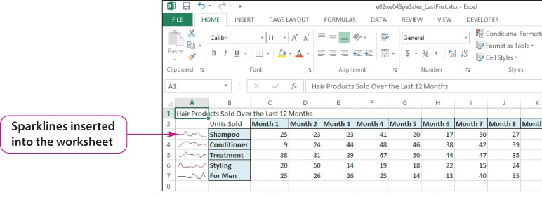
Use Sparklines and Data Bars to Emphasize Data
Notes:
Sparklines are small charts that are embedded into the cells in a worksheet, usually beside the data, to facilitate quick analysis of trends. A sparkline can be used within a worksheet to give an immediate visual trend analysis, and it adjusts as the source data changes. Sparklines can graphically depict the data over time through either a line chart or a bar chart that accumulates the data.
To insert sparklines, click Line in the Sparklines group on the INSERT tab, and in the Create Sparklines dialog box, select the range.
Information on using sparklines and data bars to emphasize data continues on the next slide.

Slide 25
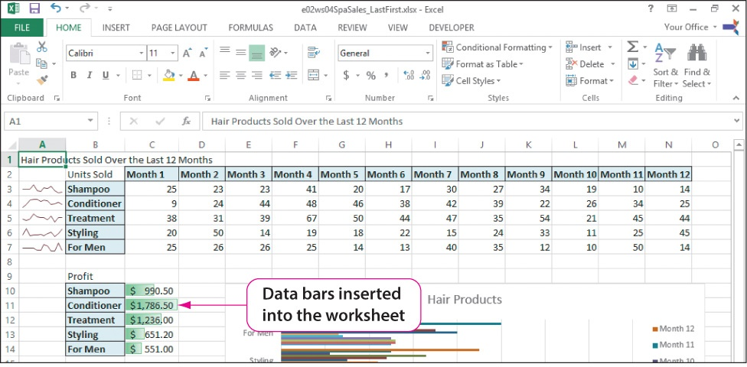
Use Sparklines and Data Bars to Emphasize Data
Notes:
Unlike sparklines, data bars are components of the Conditional Formatting feature. To insert data bars, click Conditional Formatting in the Styles group on the HOME tab and point to Data Bars. From the Data Bars gallery, select the desired color with a solid or gradient pattern.

Slide 26
Recognize and Correct Confusing Charts
Common charting issues:
Insufficient content
Too much information
Incorrect chart type
Chart readability
Misleading information or labeling
Notes:
The process of working with and creating visually appealing charts with clear messages involves recognizing when you have a confusing chart. It is possible to have too much information or ambiguous information. This can include missing labels or legends, or textual information on a chart that is not clear.
The following are common issues you should try to avoid in the development of charts:
Not enough context; users do not understand the chart
Consider adding axes and chart titles and data labels.
Too much information is on the chart
Consider using a subset of the data, rather than all the data and summarize the data so it is consolidated.
Incorrect chart type is used
Choose a type more appropriate, such as a line chart for trends.
Chart has issues with readability
Check the color scheme to ensure text is readable and font characteristics, such as font type or font size.
Move data labels, and remove excess information.
Resize the overall chart to provide more area to work.
Information or labeling is misleading
Check the scaling to ensure it is appropriate and labeled for the correct units.

Slide 27
Summary
Modifying charts:
Chart modification buttons:
Chart Elements
Chart Styles
Chart Filters
CHART TOOLS conceptual tabs:
DESIGN
FORMAT
Notes:
You can modify a chart by using the Chart Elements, Chart Styles, and Chart Filters buttons, and the CHART TOOLS DESIGN and FORMAT conceptual tabs.

Slide 28
Summary (Continued)
Modifying charts:
Positioning
Types
Layouts
Styles
Titles and axis labels
Coloring
Notes:
You can modify a chart by:
Positioning a chart on the worksheet with the data or on a new sheet
Selecting the appropriate chart type, such as pie, line, column, or bar
Using layouts, which focus on the location of components
Using styles, which focus on component colors and effects
Changing a chart’s title and axis labels, such as changing, formatting, and positioning text
Adding color to chart objects, such as changing fill colors or adding a border

Slide 29
Summary (Continued)
Emphasizing data:
Sparklines
Data bars
Recognize and correct confusing charts
Too much or ambiguous information
Incorrect chart type
Notes:
You can emphasize data by using sparklines and data bars to clarify information and understand trends.
Charts should be visually appealing and with clear messages. You should check to see if you:
Have too much or ambiguous information, such as a missing label or legend
Are using an incorrect chart type, such as using a line chart instead of a pie chart

